Slide 1

Mastering Git & GitHub
A 5-Day Workshop: From Local Commits to Collaborative Workflows

Slide 2
Day 1: The Local Setup
Installation, Configuration, and Your First Repository

Slide 3
Day 1 Agenda (1 Hour)
What is Version Control? (10 min)
Installation & Configuration (10 min)
The Three States of Git (10 min)
Your First Commit: init, add, commit (15 min)
Workshop & Q&A (15 min)

Slide 4


What is Version Control?
What is a VCS?
Why Git?
A Version Control System (VCS) is a tool that records changes to files over time so you can recall specific versions later. It's a "save" button on steroids.
Git is a Distributed VCS. This means everyone on the team has a full, local copy of the project's history. This makes it:
➔
Fast: Most operations are local.
Think of it as a time machine for your code. You can undo mistakes, review history, and see who changed what, and why.
➔
Reliable: You have multiple backups.
➔
Flexible: You can work completely offline.

Slide 5

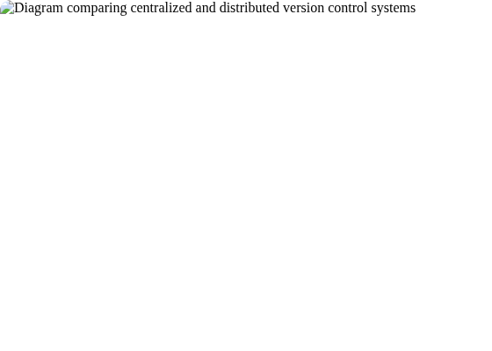
Centralized vs. Distributed
Centralized (e.g., SVN)
A single central server holds all the files and history. You "check out" files, work on them, and "check in" changes.
➔
Pro: Easy to understand.
➔
Con: Single point of failure. Slow (requires network).
Distributed (e.g., Git)
Every developer has a full, local copy (a "clone") of the entire repository, including its history.
➔
Pro: Fast, offline work, powerful branching.
➔
Con: Steeper learning curve (at first).

Slide 6





Installation
Windows
macOS
Linux
Download the installer from git-scm.com. Run the installer and accept the default settings. This will install "Git Bash", an excellent terminal.
The easiest way is with Homebrew. Open Terminal and run: brew install git. Alternatively, you can install Apple's "Command Line Tools".
Use your distribution's package manager. For example, on Ubuntu/Debian: sudo apt-get install git.

Slide 7
First-Time Configuration
You only need to do this once. This information is attached to every commit you make.
Set Your Name
This is your identity. Use your real name.
Set Your Email
Use the same email you will use for GitHub.
Set Default Branch Name
A modern best practice.

Slide 8


The Three States of Git
1. Working Directory
All your project files and folders. This is where you edit, add, and delete files. Any file you haven't "added" is just here.
2. Staging Area (Index)
A "holding area" or "shopping cart" for changes you want to include in your next commit. This lets you build up a commit piece by piece.
3. Repository (.git dir)
The permanent snapshot of your project's history. Commits are saved here in the hidden .git folder.

Slide 9
Step 1: Initialize Repository
git init creates a new Git repository in your current folder.
Initialize the Repository
Creates the hidden .git folder.
Git init
Check the Status
git status is your most-used command. It tells you what's going on.

Slide 10
Step 2: Stage Changes
git add moves changes from the Working Directory to the Staging Area.
Create a File
First, we create a file. Git sees it as "untracked".
Stage the File
Now we "add" it to staging. Git now tracks this file.

Slide 11
Step 3: Commit Changes
git commit takes everything in the Staging Area and saves it as a permanent snapshot in your Repository.
Commit the Snapshot
The -m flag is for the "message". Make it descriptive!
Check Status Again
Your working directory is now "clean".

Slide 12

Step 4: Check Your History
git log
This command shows you the history of all your commits, starting with the newest one.
Each commit has:
➔
A unique ID (the "hash")
➔
The Author (you!)
➔
The Date
➔
The commit message
Useful Flags
--oneline: Shows a compact view.
--graph: Draws a text-based graph of branches.
--all: Shows all branches, not just the current one.

Slide 13
Day 1 Workshop (15 min)
Your Mission:
Install & Configure
1. Make sure Git is installed (git --version).
2. Configure your user.name and user.email.
Make Your First Commits
1. Create a new folder (e.g., git-practice) and cd into it.
2. Run git init.
3. Create a file README.md and add some text.
4. Commit 1: git add README.md and git commit -m "Add README".
5. Create another file INFO.txt.
6. Commit 2: git add . and git commit -m "Add INFO".
Check Your Work
1. Run git log --oneline. You should see your two commits!

Slide 14
Day 2: Branching & Merging
Work in Parallel and Integrate Changes Safely

Slide 15
Day 2 Agenda (1 Hour)
What is a Branch? (10 min)
Core Branching Commands (10 min)
Merging Changes (10 min)
Merge Conflicts! (15 min)
Undoing Changes (5 min)
Workshop & Q&A (10 min)

Slide 16

What is a Branch?
A Lightweight Pointer
A branch is simply a movable pointer to a specific commit. It's not a copy of your project; it's just a label.
The main branch is just a branch. It's not special, other than by convention it's the "source of truth".
What is HEAD?
HEAD is another pointer. It points to the branch you are currently on. When you checkout a branch, you are moving HEAD.

Slide 17

Why Branch? (The Workflow)
Isolate Your Work
Branches let you work on a new feature (e.g., feature/login) or a bug fix (e.g., bug/fix-typo) in a safe, isolated environment.
➔
If you make a mistake, you just delete the branch. The main branch is never harmed.
➔
You can work on 5 different features at once by switching branches.
➔
It keeps the main branch clean and stable.

Slide 18


Core Branching Commands
Create / List
Switch
List all branches: (* shows current one)
git branch
Switch to another branch:
git checkout feature/add-bio
Create a new branch:
git branch feature/add-bio
(Newer command):
git switch feature/add-bio
(This creates the branch, but does not switch you to it.)
Create AND Switch (Shortcut):
git checkout -b new-feature

Slide 19

Merging: The "Fast-Forward"
The "Happy Path"
This happens when the main branch has no new commits since you created your feature branch.
Git sees that your feature branch is just "ahead" of main, so it simply moves the main pointer forward to match your branch. No new "merge commit" is created.
Commands:
git checkout main
git merge feature/add-bio

Slide 20
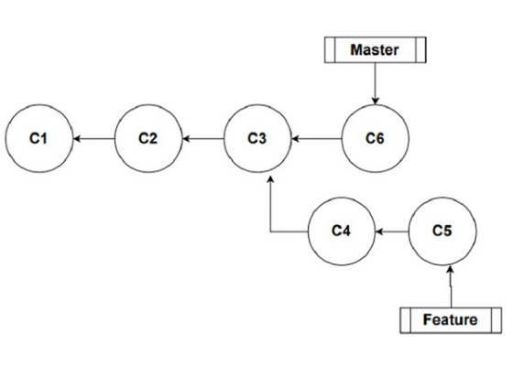
Merging: The 3-Way Merge
The "Real-World" Merge
This happens when both your main branch AND your feature branch have new commits. (e.g., a teammate merged a hotfix to main).
Git can't just move the pointer. It has to combine the two histories and create a new merge commit that has two parents.
Commands:
git checkout main
git merge feature/add-bio
(This may open an editor to type a merge message)

Slide 21






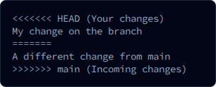
The DREADED Merge Conflict
What is it?
What it Looks Like
How to Fix It
This happens when Git can't automatically merge. It means you and another commit (e.g., on main) edited the same line(s) in the same file, and Git doesn't know which change to keep.
Git stops and adds "conflict markers" to the file:
1. Open the file.
2. Delete the markers (<<<, ===, >>>).
3. Manually edit the file to be correct (keep one, keep both, write new).
4. git add
5. git commit (no -m needed)

Slide 22
Quick Tip: Undoing Changes
Discard Working Directory Changes
(You edited a file but haven't staged it. Throws away your edits.)
Unstage a File
(You ran git add but want to remove it from staging.)
Fix Your Last Commit
(Forgot a file? Typo in the message? No problem.)

Slide 23
Quick Tip: Cleaning Up Branches
After your feature is merged into main, you can delete the branch to keep your repository tidy.
Safe Delete
This is the normal way. It won't let you delete a branch that *hasn't* been merged yet.
Force Delete
Use this if you made a mistake and want to abandon a branch and all its commits.

Slide 24
Day 2 Workshop (10 min)
Your Mission:
Branch It
1. In your git-practice repo, create and switch to a new branch: git checkout -b feature/add-bio.
2. Create a bio.txt file and add your name.
3. git add . and git commit -m "Add bio".
Create a 3-Way Merge
1. Switch back to main: git checkout main.
2. Edit your README.md file. Add "My Git Practice Project".
3. git add . and git commit -m "Update README on main".
Merge It
1. Merge your feature branch: git merge feature/add-bio.
2. A text editor will open for the merge commit message. Just save and quit (:wq in Vim).
3. Run git log --oneline --graph. See the history diverge and come back together!

Slide 25
Day 2: Questions?

Slide 26
Day 3: Going Remote
Connecting Your Local Repository to GitHub

Slide 27
Day 3 Agenda (1 Hour)
Git vs. GitHub (5 min)
Authentication (SSH vs. HTTPS) (10 min)
git clone (5 min)
git remote & git push (15 min)
git pull & git fetch (10 min)
Workshop & Q&A (15 min)

Slide 28


Git vs. GitHub
Git is the Tool
Git is the command-line tool that runs on your computer. It manages your history (git commit, git branch). It works 100% offline.
GitHub is the Service
GitHub is a website that hosts your Git repositories. It's a "remote" server where you can store a copy of your .git folder. It adds collaboration features:
•
Pull Requests & Code Reviews
•
Issue Tracking
•
Automation (Actions)

Slide 29


Authentication: How You Prove You're You
HTTPS (+ PAT)
SSH (Recommended)
Uses a https://... URL. This is easy to start with, but you can't use your main GitHub password.
Uses a git@github.com:... URL. This is the professional standard. You generate a "key pair" (public/private) on your computer.
You must generate a Personal Access Token (PAT) from GitHub's settings and use that token as your password. This is secure but can be annoying to set up.
You upload your public key to GitHub once. Your computer then uses the private key to authenticate automatically. No passwords needed!

Slide 30


Connecting to a Remote
Option 1: git clone
Option 2: git remote add
Use this for existing projects. You find a repo on GitHub and want a local copy.
Use this for new projects you started locally. You ran git init and now want to back it up to GitHub.
git clone
1. Create a new, empty repo on GitHub (don't add a README).
This command automatically:
2. Get the URL.
➔
Downloads the entire repo.
3. git remote add origin
➔
Creates the origin remote pointing to the URL.
➔
Checks out the main branch.

Slide 31
Deep Dive: git clone
git clone is the easiest way to get started on a project.
Get the URL
Go to any GitHub repo and click the green "Code" button. Choose SSH or HTTPS.
Run the Command
This will create a new folder with the repo's name.
You're Ready!
You can now cd some-project and start working. It's already linked to the remote.

Slide 32
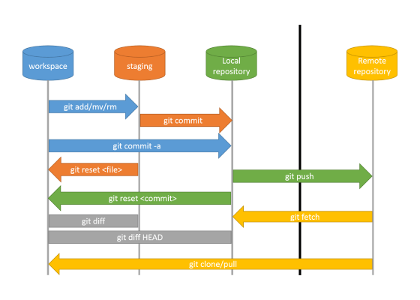
Deep Dive: git push
Upload Your Commits
git push sends your local commits to the remote repository (origin).
The first time you push a new branch, you must "set the upstream" (-u). This links your local branch to the remote branch.
Commands:
First push on main:
git push -u origin main
Subsequent pushes:
git push

Slide 33
Deep Dive: git pull
Sync With Your Team
git pull updates your local branch with any new commits from the remote repository. Your teammates push, you pull.
This is two commands in one:
➔
git fetch: Downloads the new data.
➔
git merge: Merges the downloaded data into your current branch.
Always pull before you push! This ensures you have your team's latest work before you add yours.

Slide 34


Fetch vs. Pull
git fetch (The Safe Way)
git pull (The Easy Way)
Downloads all new data from the remote, but does not integrate it. Your working files are untouched.
This is a shortcut for fetch + merge. It downloads and immediately tries to merge into your current branch.
This is "safe" because you can look at the changes (git log origin/main) before you decide to merge them.
It's convenient, but be ready to handle merge conflicts if they appear.
Workflow:
git fetch origin
git merge origin/main
Workflow:
git pull origin main

Slide 35
Understanding Remote Branches
Your local repo doesn't just have your branches. It has read-only "remote-tracking" copies of the remote's branches.
main
This is your local branch. You can edit it.
origin/main
This is the remote-tracking branch. It's a read-only pointer to origin's main branch *the last time you fetched*. You can't edit it.
View all branches:
git branch -a (shows local and remote-tracking)

Slide 36
Day 3 Workshop (15 min)
Your Mission:
1. Create Remote Repo
Go to GitHub.com. Create a new, empty repository (no README, no .gitignore). Call it git-practice.
2. Link & Push
In your local git-practice folder, add the remote (copy the SSH or HTTPS URL from GitHub):
git remote add origin
git push -u origin main (and push your feature/add-bio branch too!)
3. Clone It
cd .. (go up one directory).
git clone git-practice-clone (clone to a *new* folder).
4. Push & Pull
cd git-practice-clone, edit README.md, commit, and git push.
cd ../git-practice (go back to original), and run git pull. See the new change appear!

Slide 37
Day 3: Questions?

Slide 38
Day 4: Collaborative Workflows
Pull Requests, Code Reviews, and Forking

Slide 39
Day 4 Agenda (1 Hour)
The Feature Branch Workflow (10 min)
What is a Pull Request (PR)? (10 min)
How to: Review a PR (10 min)
How to: Merge a PR (5 min)
The Forking Workflow (10 min)
Workshop (Pairs) & Q&A (15 min)

Slide 40


The Pull Request Workflow
The Professional Workflow
➔
Get the latest main: git checkout main & git pull.
➔
Create your feature branch: git checkout -b my-feature.
➔
Do your work: Edit, add, commit.
➔
Push your branch to remote: git push origin my-feature.
➔
Go to GitHub and Open a Pull Request.
➔
Your team reviews, comments, and approves.
➔
The PR is merged into main.

Slide 41
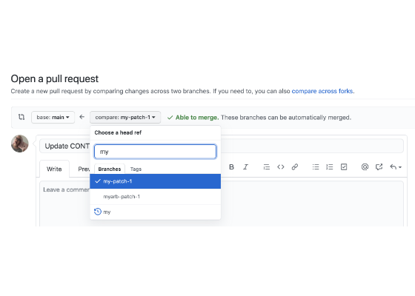
What is a Pull Request?
A Pull Request (PR) is a formal way to propose changes. It's not a Git command, it's a GitHub feature.
It's a dedicated web page that tracks:
➔
The conversation about your changes.
➔
The code review (comments, suggestions).
➔
The commits in your branch.
➔
Status checks (like automated tests) to see if your code is safe to merge.

Slide 42
How to: Open a Pull Request
1. Push Your Branch
First, git push origin my-feature.
2. Go to GitHub
GitHub will see your new branch and show a yellow banner: "my-feature had recent pushes".
3. Click "Compare & pull request"
This opens the PR form.
4. Write a Good Description
Fill out the title (e.g., "Add login page") and a description of *what* you changed and *why*. Add reviewers.
5. Click "Create pull request"
Your team is now notified to review your code.

Slide 43
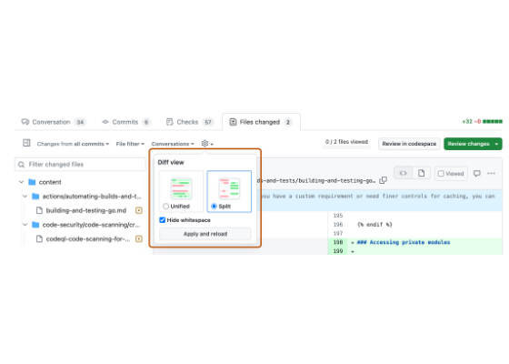
How to: Review a Pull Request
A Team Responsibility
Code reviews are how teams maintain quality and share knowledge. As a reviewer, you check for:
➔
Bugs or logic errors.
➔
Readability and style.
➔
Good test coverage.
The "Files Changed" Tab
This is where you see the "diff". You can click on any line to add a comment or suggestion. When you're done, you can "Approve", "Request changes", or "Comment".

Slide 44



How to: Merge a Pull Request
Merge Commit
Squash and Merge
Rebase and Merge
The default. This creates a 3-way merge commit, just like git merge. It preserves the exact history of the branch. (Good, but can be "noisy").
Combines all of your feature branch's commits (e.g., "fix typo", "oops") into one single commit on main. This keeps the main history very clean.
Re-plays your feature commits on top of main, then fast-forwards. This creates a perfectly linear history. (Clean, but advanced).

Slide 45
Scenario: main Changed!
You are working on your PR, but your teammate just merged *their* PR. Your branch is now out-of-date. You must update it.
1. Get Latest main
git checkout main
git pull origin main
2. Go Back to Your Branch
git checkout my-feature
3. Merge main into Your Branch
git merge main (Fix any conflicts locally!)
4. Push the Update
git push origin my-feature (The PR updates automatically)

Slide 46
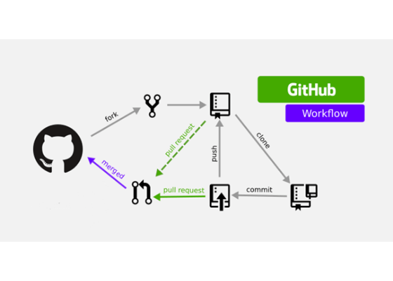
The Forking Workflow (Open Source)
When You Don't Have Write Access
You can't push to a project you don't own (like React or Linux). The solution is a "Fork".
A Fork is a personal, server-side copy of a repository. You have 100% control over your fork.
The Flow:
➔
Fork the repo on GitHub (creates your-name/repo).
➔
Clone *your fork* (git clone ...).
➔
Push changes to *your fork*.
➔
Open a PR from *your fork* to the *original ("upstream") repo*.

Slide 47
Quick Tip: Syncing Your Fork
What if the original "upstream" repo changes? Your fork is now out-of-date. You need to sync it.
1. Add "Upstream" Remote
(You only do this once)
2. Fetch from Upstream
This gets all the new commits from the original repo.
3. Merge into Your main
git checkout main
git merge upstream/main
4. Push to Your Fork
git push origin main (This updates *your* fork on GitHub)

Slide 48
Day 4 Workshop (15 min)
Your Mission (Work in pairs!):
Partner A: The Author
1. Create a new branch: git checkout -b fix-readme-typo.
2. Make a small change (fix a typo, add a line) to README.md.
3. Commit and git push origin fix-readme-typo.
4. Go to GitHub, open a Pull Request, and assign Partner B as the reviewer.
Partner B: The Reviewer
1. Go to the Pull Request page on GitHub.
2. Go to the "Files Changed" tab.
3. Click on a line and add a comment (e.g., "Good catch!").
4. Go back to "Conversation" and "Approve" the PR.
Partner A: Merge your own PR (click the green "Merge" button).
Both: git checkout main and git pull to get the change!

Slide 49
Day 4: Questions?

Slide 50
Day 5: Advanced Tools & Good Habits
Stashing, Rebasing, and Keeping Your Repo Clean

Slide 51
Day 5 Agenda (1 Hour)
Ignoring Files: .gitignore (10 min)
Saving Work: git stash (10 min)
Cleaning History: git rebase (10 min)
Undoing Commits: reset vs. revert (10 min)
Good Git Habits (5 min)
Workshop & Q&A (15 min)

Slide 52

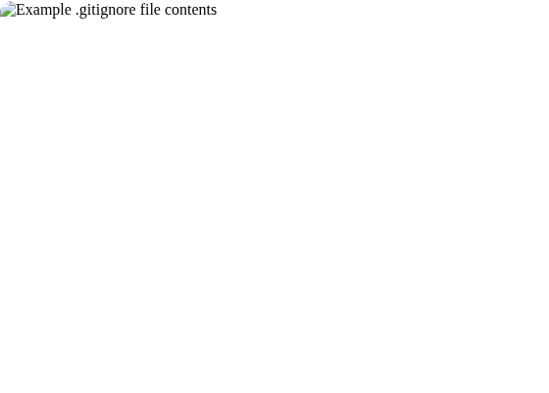
Ignoring Files: .gitignore
What is it?
A plain text file named .gitignore that tells Git which files and folders to ignore.
Ignored files won't show up in git status and can't be added with git add ..
What to Ignore?
➔
Dependencies: node_modules/
➔
Secrets: .env, keys.json
➔
Build Output: /build, /dist
➔
OS Files: .DS_Store, Thumbs.db
Rule: If it can be generated, it shouldn't be in Git.

Slide 53
git stash: Save for Later
The Problem
The Solution: git stash
You're in the middle of a feature, but your code is broken. Your boss runs over: "URGENT! Fix a typo on main!"
Stash saves your "dirty" working directory (uncommitted changes) and gives you a clean slate.
You can't commit broken code, and you don't want to lose your changes. What do you do?
git stash (Save changes)
git checkout main (Fix bug, commit)
git checkout my-feature (Go back)
git stash pop (Get changes back!)

Slide 54
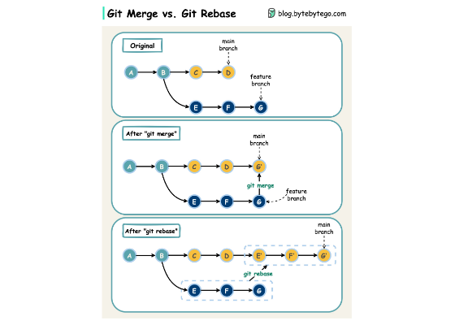
git rebase: A Cleaner History
rebase vs. merge
git merge main (from Day 4) is one way to update your branch. It creates a merge commit.
git rebase main is another way. It rewrites your history. It takes your branch's commits, moves them to the side, pulls in main's new commits, and then "re-plays" your commits one-by-one on top.
Result: A perfectly clean, linear history. No merge commits.

Slide 55
The Golden Rule of Rebasing
DO NOT rebase commits that exist on a public, shared branch.
"
"
— Every Git Developer, Everywhere
Rebasing rewrites history. If you rebase main, you will destroy the repo for everyone else. Only rebase your own local branches before you share them in a PR.

Slide 56



git reset: The Time Machine
--soft
--mixed (default)
--hard (DANGEROUS)
git reset --soft HEAD~1
Undoes your last commit, but leaves the changes in your Staging Area. (Good for "oops, I forgot a file").
git reset HEAD~1
Undoes your last commit and un-stages the files, leaving them in your Working Directory.
git reset --hard HEAD~1
Undoes your last commit and DELETES all changes. There is no undo. (Use with extreme caution).

Slide 57
The Safe Undo: git revert
git reset changes history. It's bad to use on a public branch. What if you need to undo a bad commit on main?
Use git revert!
A "Forward-Facing" Undo
git revert does not delete history.
Creates a New Commit
It creates a brand new commit that does the exact opposite of the bad commit. This is safe to push to a shared branch.

Slide 58
Good Git Habits
Commit Small, Commit Often
Don't wait all day to make one giant commit. Make small, logical commits.
Write Good Commit Messages
Not "stuff" or "changes". Write "Feat: Add login validation" or "Fix: Correct typo in footer".
Pull Before You Push
Always run git pull before you git push to avoid conflicts.
Branch for Everything
Never commit directly to main. Ever.
Don't Commit Broken Code
Your branch should always be in a working state. Use git stash if it's not.

Slide 59
Day 5 Workshop (15 min)
Your Mission:
1. Use .gitignore
1. Create a file .gitignore.
2. Inside it, add a new line: *.log
3. Create a file test.log.
4. Run git status. Notice that test.log doesn't show up! (But .gitignore does).
5. git add .gitignore and commit it.
2. Use git stash
1. Edit README.md but do not commit it.
2. Run git stash. See your changes disappear!
3. Run git stash pop. See your changes come back!

Slide 60






What's Next?
GitHub Actions (CI/CD)
GitHub Pages
Git GUIs
Automate your workflow. Run tests every time you push, or deploy your website automatically when you merge to main.
Host a static website (like a portfolio or blog) for free, directly from a GitHub repository.
The terminal is powerful, but GUIs (Graphical User Interfaces) can make visualizing history easier. Check out VS Code's built-in Git tools, GitKraken, or SourceTree.

Slide 61
Day 5: Final Questions?

Slide 62
Thank You!
You're now ready to use Git & GitHub. Happy coding!

Slide 63







Image Sources
https://i.ytimg.com/vi/MAoAY1wYJuE/hq720.jpg?sqp=-oaymwEhCK4FEIIDSFryq4qpAxMIARUAAAAAGAElAADIQj0AgKJD&rs=AOn4CLDelhYQ7S9C5HAnCLo0NGFt8rAhfw
Source: www.youtube.com
https://i.sstatic.net/E4xNk.png
Source: stackoverflow.com
https://i.sstatic.net/k5Gdu.png
Source: stackoverflow.com
https://i.sstatic.net/rTxx9.png
Source: stackoverflow.com
https://www.tutorialspoint.com/assets/questions/media/51682/3_way_merge1.jpg
Source: www.tutorialspoint.com
https://www.devguide.at/wp-content/uploads/2019/06/git-basic-commands.png
Source: www.devguide.at

Slide 64






Image Sources
https://docs.github.com/assets/cb-87213/images/help/pull_requests/pull-request-review-edit-branch.png
Source: docs.github.com
https://docs.github.com/assets/cb-109516/images/help/pull_requests/diff-settings-menu.png
Source: docs.github.com
https://miro.medium.com/1*NbRsghbBK86UskBm5WGu7w.png
Source: medium.com
https://blog.yarsalabs.com/content/images/2022/10/image-9.png
Source: blog.yarsalabs.com
https://assets.bytebytego.com/diagrams/0203-git-merge-git-rebase.jpg
Source: bytebytego.com

